Slide 1
PCI Express
7 – July - 2020
Eng. # 3 SW Eng., James Hsiao

Slide 2
Agenda
Architecture
Configuration
Address Space & Transaction Routing
TLP & DLLP Elements
Flow Control
ACK/NAK Protocol
Physical Layer – Logical
Link Initialization & Training
Power Management
Examples

Slide 3
PCI Express
Architecture

Slide 4
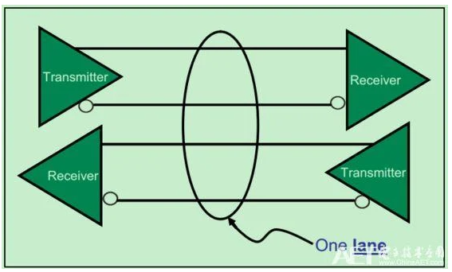
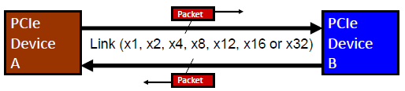
Architecture
Serial Transport
Links and Lanes
Dual Simplex point-to-point serial connection
Independent transmit and receive sides
Scalable Link Widths
x1, x2, x4, x8, x12, x16, x32
Scalable Link Speeds
2.5, 5.0, 8.0, 16.0 GT/s, 32GT/s
Packet based transaction protocol

Slide 5
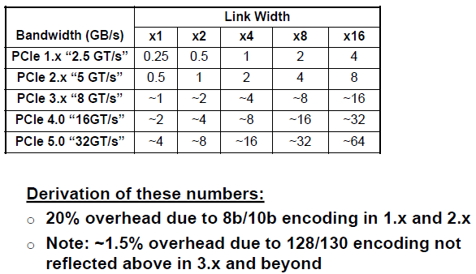
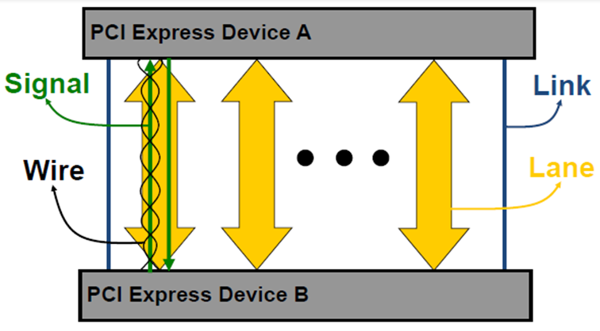
Architecture
Bandwidth

Slide 6
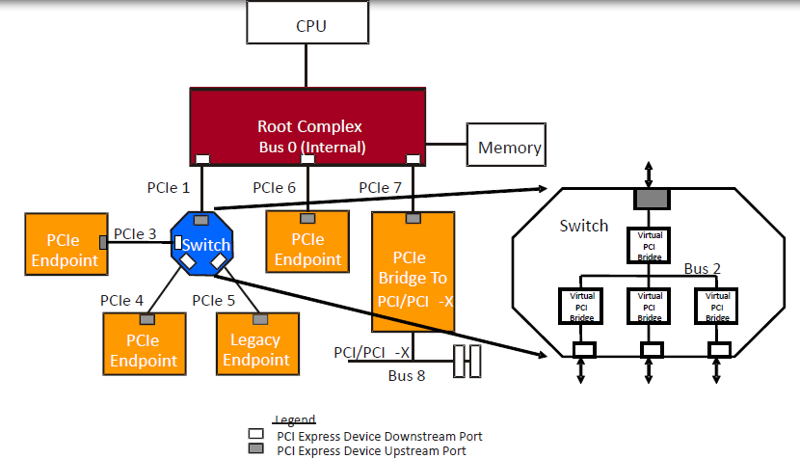
Architecture
Definitions
Root Complex denotes the root of an I/O hierarchy that connects the CPU/memory subsystem to the I/O.
A PCI Express to PCI/PCI-X Bridge provides a connection between a PCI Express fabric and a PCI/PCI-X hierarchy.
A Switch is defined as a logical assembly of multiple virtual PCI-to-PCI Bridge devices.
Endpoint refers to a type of Function that can be the Requester or Completer of a PCI Express transaction either on its own behalf or on behalf of a distinct non-PCI Express device (other than a PCI device or host CPU). Endpoints are classified as either legacy or PCI Express Endpoints.

Slide 7
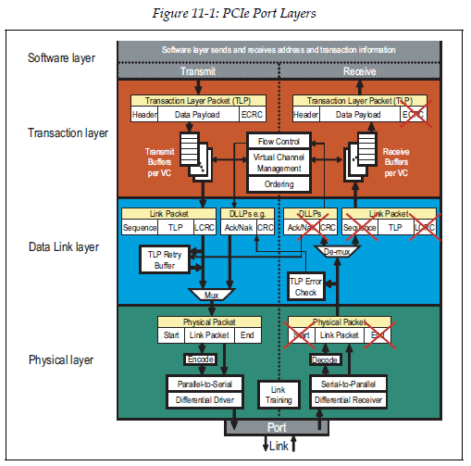
Architecture
Device Layers
The Transaction Layer’s primary responsibility is the assembly and disassembly of TLPs. TLPs are used to communicate transactions, such as read and write, as well as certain types of events. The Transaction Layer is also responsible for managing credit-based flow control for TLPs.
The Data Link Layer, serves as an intermediate stage between the Transaction Layer and the Physical Layer. The primary responsibilities of the Data Link Layer include Link management and data integrity, including error detection and error correction. The Data Link Layer also generates and consumes DLLPs that are used for Link management functions.
The Physical Layer includes all circuitry for interface operation, including driver and input buffers, parallel-to-serial and serial-to-parallel conversion, PLL(s), and impedance matching circuitry. It also includes logical functions related to interface initialization and maintenance. This Layer is responsible for converting information received from the Data Link Layer into an appropriate serialized format and transmitting it across the PCI Express Link at a frequency and width compatible with the device connected to the other side of the Link.
Notes:
Transaction Layer Packets (TLPs)
Data Link Layer Packets (DLLPs)

Slide 8
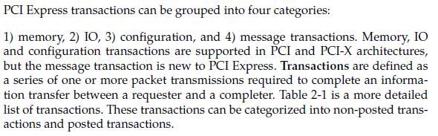
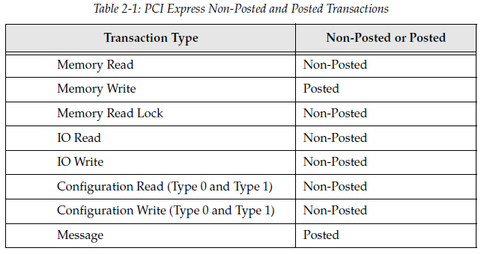
Architecture
Transaction
Transaction Type
Notes:
Lock: no other accesses are permitted to the target device
In PCI: LOCK#

Slide 9
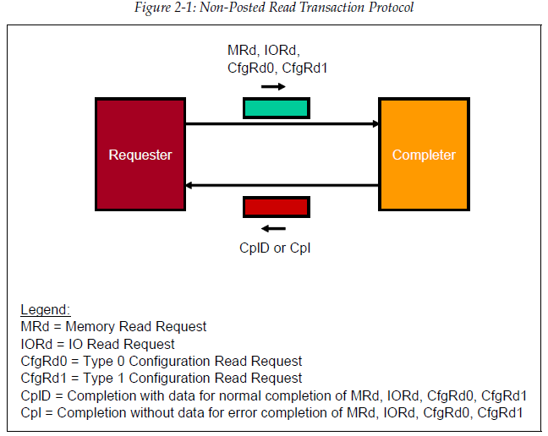
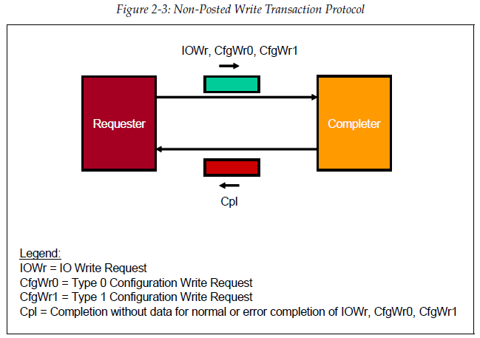
Architecture
Transaction
Non-Posted

Slide 10
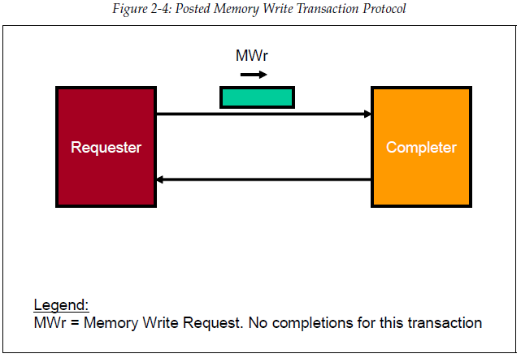
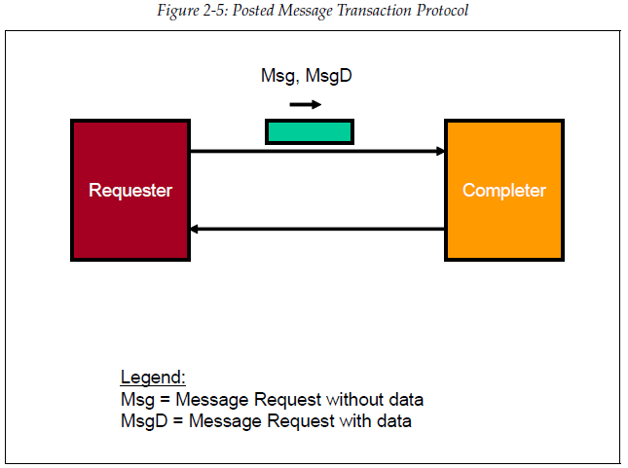
Architecture
Transaction
Posted

Slide 11
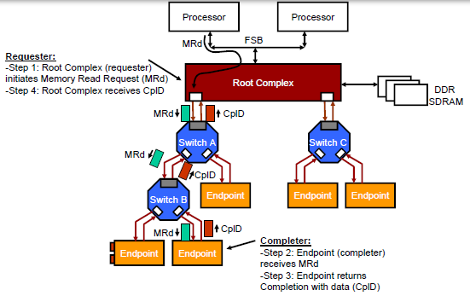
Architecture
Transaction
Programmed I/O Transaction

Slide 12
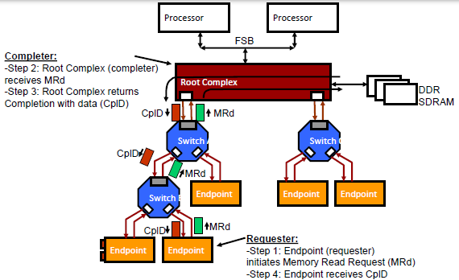
Architecture
Transaction
DMA Transaction

Slide 13
PCI Express
Configuration

Slide 14
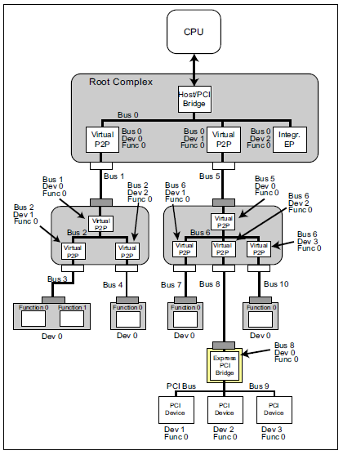
Configuration
Bus, Device and Function
Every PCIe Function is uniquely identified by the Device it resides within and the Bus to which the Device connects. This ID is commonly referred to as a ‘BDF’. Up to 256 Bus Numbers can be assigned by configuration software. The initial Bus Number, Bus 0, is typically assigned by hardware to the Root Complex. PCIe permits up to 32 device attachments on a single PCI bus. Each Device must implement Function 0 and may contain a collection of up to eight Functions. When two or more Functions are implemented the Device is called a multi-function device. These Functions may include hard drive interfaces, display controllers, ethernet controllers, USB controllers, etc. Each Function has its own configuration address space that is used to setup the resources associated with the Function.

Slide 15
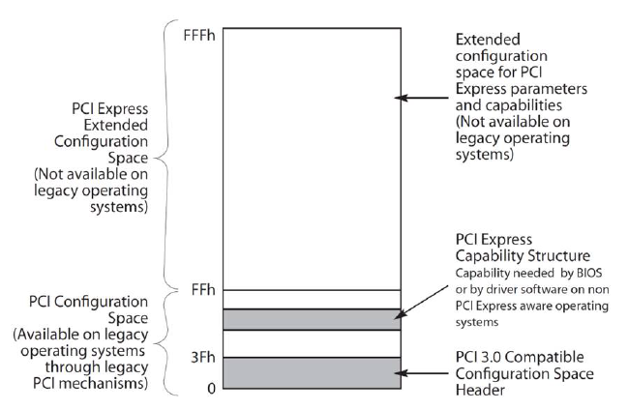
Configuration
Configuration Space
PCI Express extends the Configuration Space to 4096 bytes per Function as compared to 256 bytes allowed by PCI. PCI Express Configuration Space is divided into a PCI-compatible region, which consists of the first 256 bytes of a Function’s Configuration Space, and a PCI Express Extended Configuration Space which consists of the remaining Configuration Space.

Slide 16
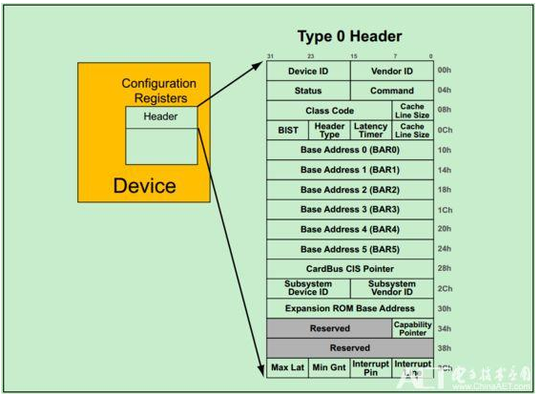
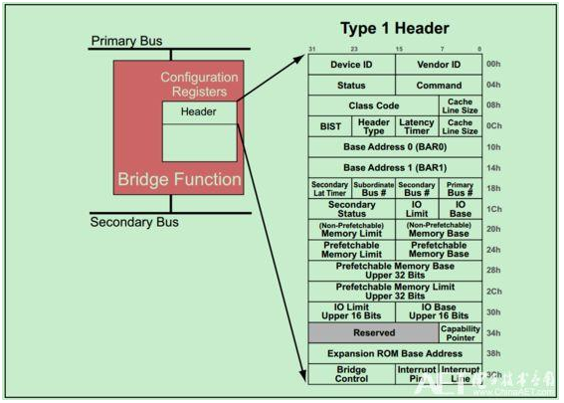
Configuration
PCI-Compatible Configuration Space

Slide 17
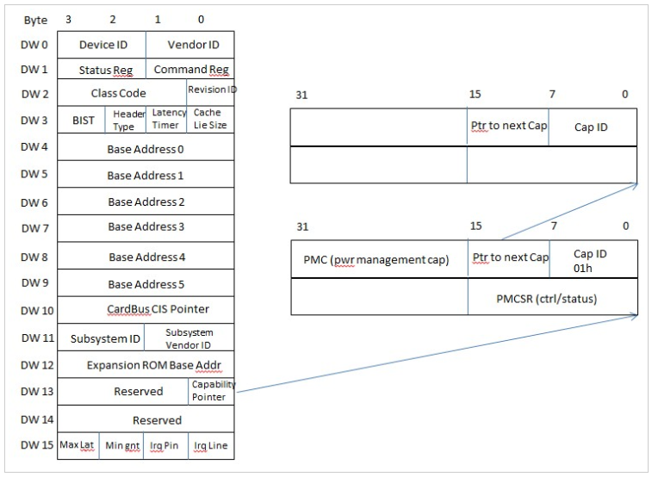
Configuration
PCI-Compatible Configuration Space
Notes:
During enumeration, system software will read capability register sets of device. Lower 8bit of DW#13 in config space is the capability pointer. It points to the 1st set of capability registers. Bit15 to 8 of the 1st capability register is the pointer pointing to the next one. For power management capability register, capability ID, lower 8bit of the 1st DW, is 01h which indicates it is power management capability register set.

Slide 18
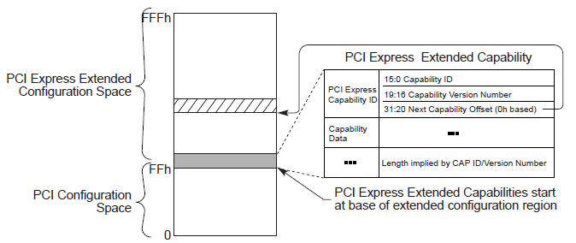
Configuration
Extended Configuration Space

Slide 19
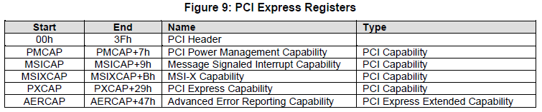
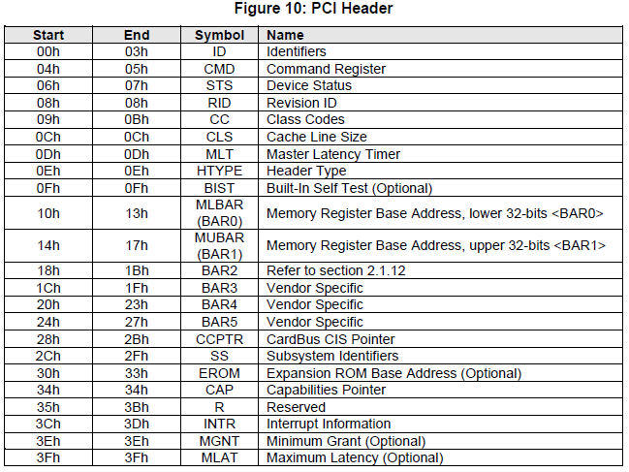
Configuration
NVMe - System Bus (PCI Express) Registers

Slide 20
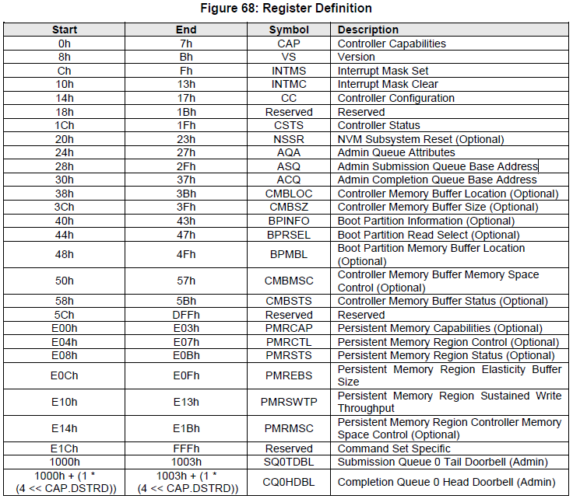
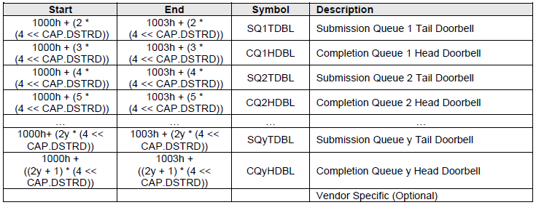
Configuration
NVMe - Controller Registers
Notes:
Controller registers are located in the MLBAR/MUBAR registers (PCI BAR0 and BAR1) that shall be mapped to a memory space that supports in-order access and variable access widths.

Slide 21
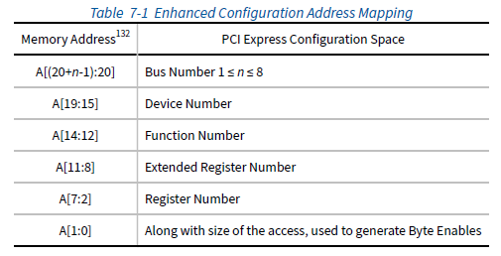
Configuration
Enhanced Configuration Access Mechanism

Slide 22
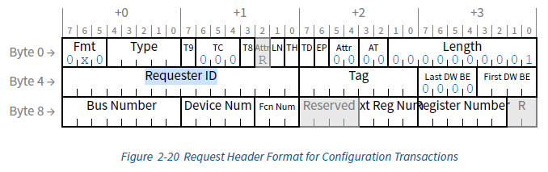
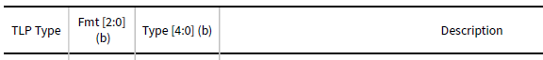
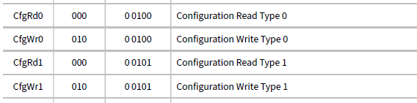
Configuration
Configuration Requests

Slide 23
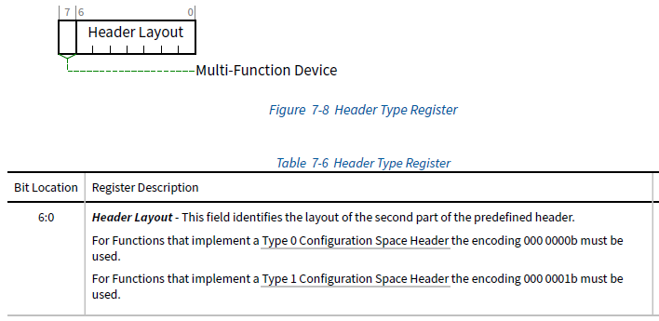
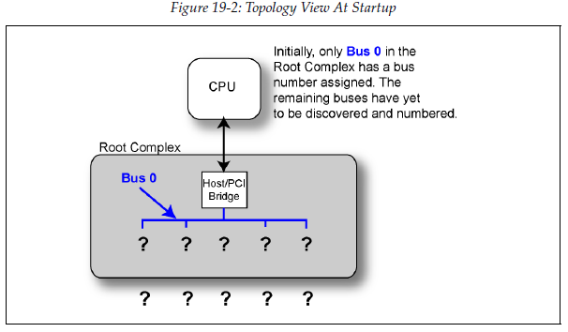
Configuration
Enumeration – Discovering the Topology

Slide 24
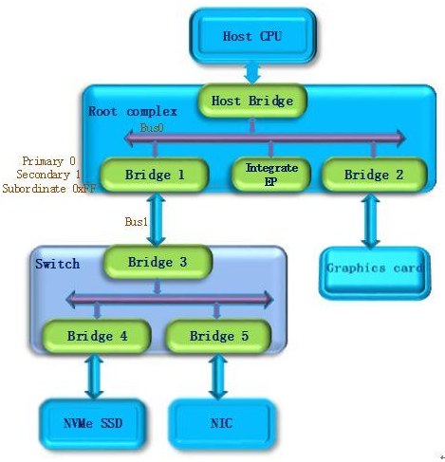
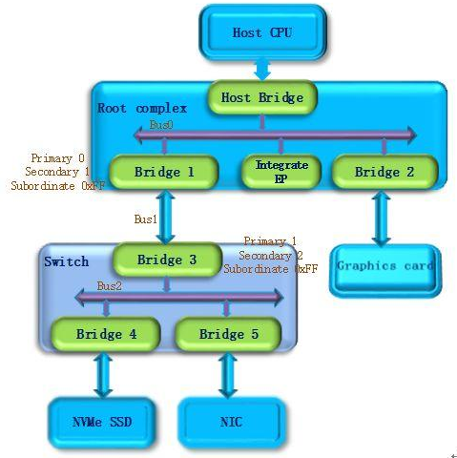
Configuration
Enumeration Example

Slide 25
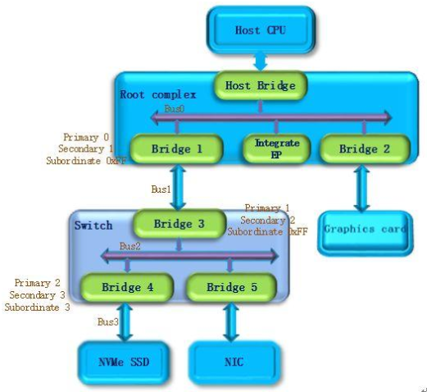
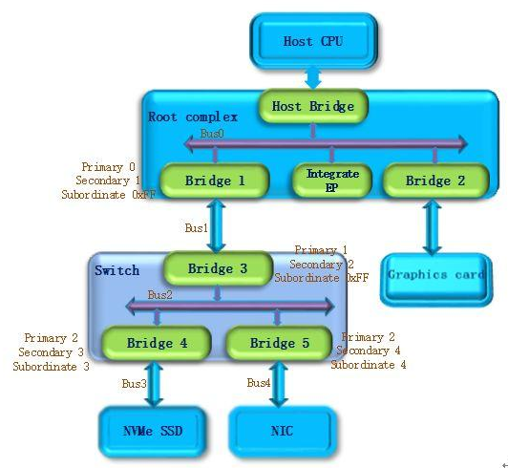
Configuration
Enumeration Example

Slide 26
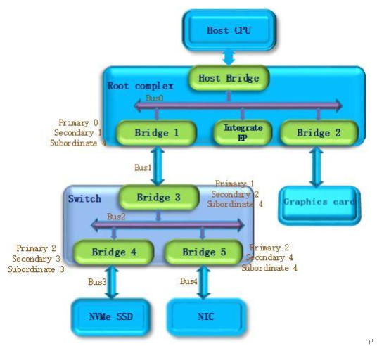
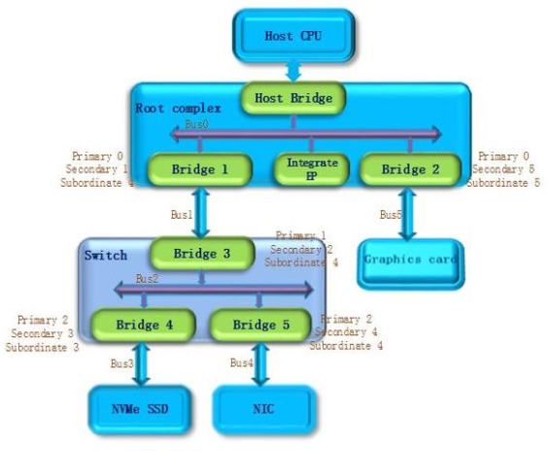
Configuration
Enumeration Example

Slide 27
PCI Express
Address Space & Transaction Routing

Slide 28
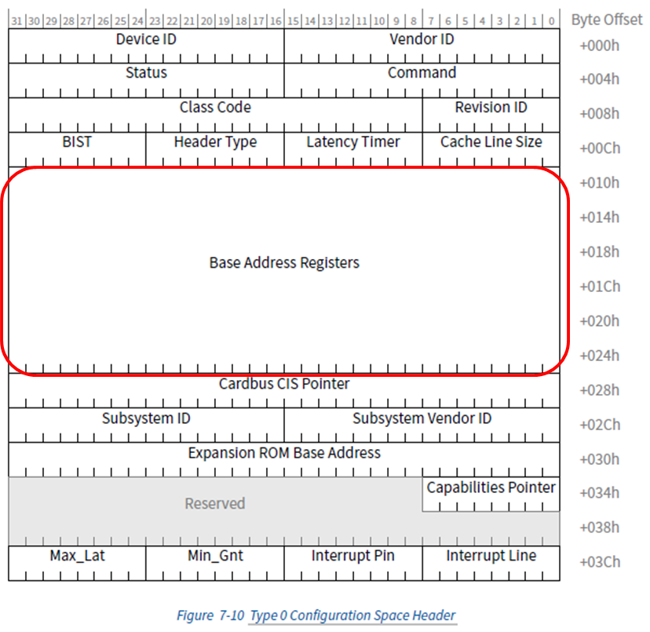
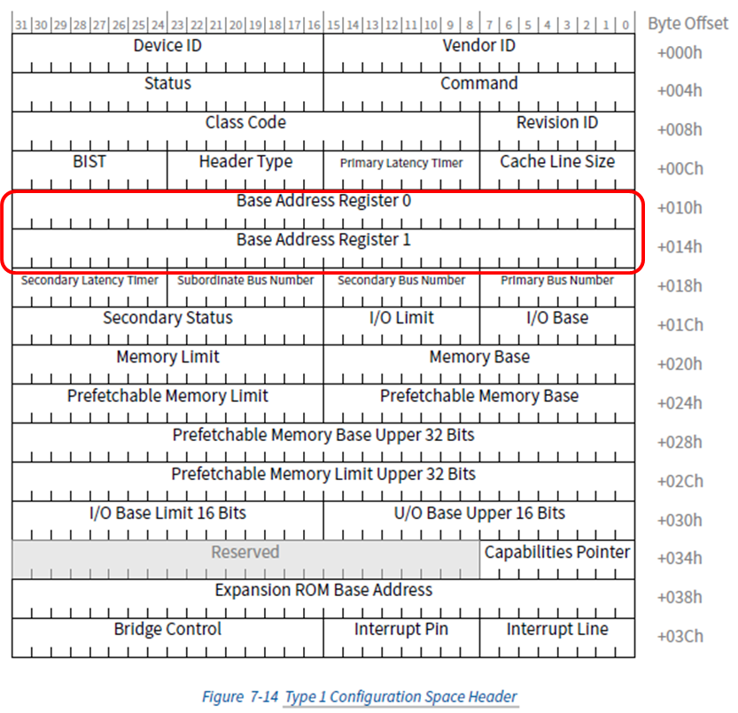
Address Space & Transaction Routing
Base Address Registers (BARs)
Notes:
System software must build a consistent address map before booting the machine to an operating system. This means it has to determine how much memory is in the system, and how much address space the Functions in the system require. After determining this information, system software can map the Functions into reasonable locations and proceed with system boot. In order to do this mapping in a device-independent manner, the base registers for this mapping are placed in the predefined header portion of Configuration Space.

Slide 29
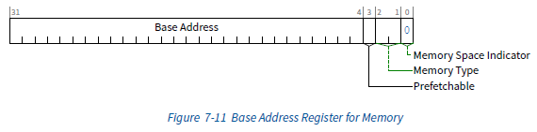
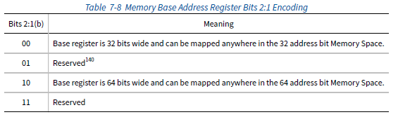
Address Space & Transaction Routing
Base Address Registers (BARs)
Notes:
Bit 0 in all Base Address registers is read-only and used to determine whether the register maps into Memory or I/O
Space. Base Address registers that map to Memory Space must return a 0b in bit 0
副作用就是指讀取某個地址時可能導致該地址內容發生變化，訪問不可預取記憶體時就不能進行優化，因為每次訪問都伴隨副作用，就和I/O埠一樣。將其控制暫存器對映到記憶體地址範圍的外設會把該範圍置為不可預取

Slide 30
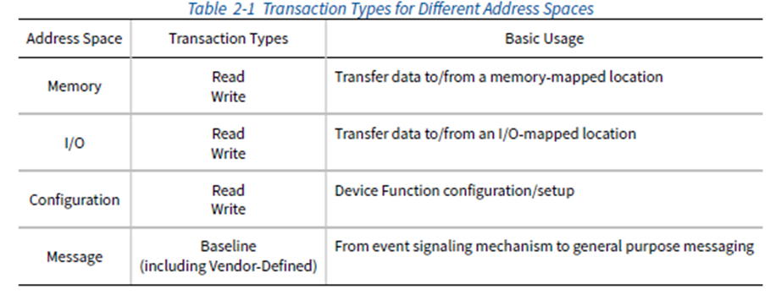
Address Space & Transaction Routing
TLP Routing Basics
Request are translated to one of four transaction types by the Transaction Layer:
Memory Read or Memory Write: Used to transfer data from or to a memory mapped location.
–The protocol also supports a locked memory read transaction variant
I/O Read or I/O Write: Used to transfer data from or to an I/O location.
–These transactions are restricted to supporting legacy endpoint devices
Configuration Read or Configuration Write: Used to discover device capabilities, program features, and check status in the 4KB PCI Express configuration space.
Messages: Handled like posted writes. Used for event signaling and general purpose messaging.
Notes:
For any TLP, a value of 1b in the TD bit indicates the presence of the TLP Digest field including an end-to-end
CRC (ECRC) value at the end of the TLP.

Slide 31
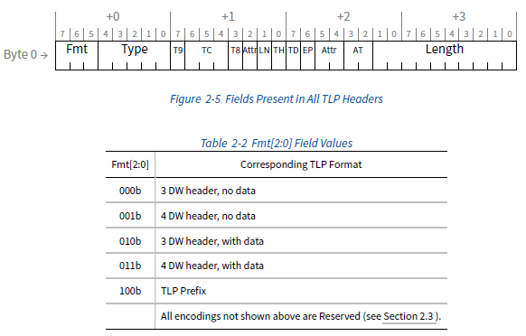
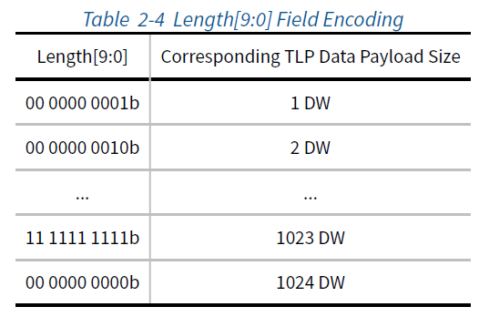
Address Space & Transaction Routing
TLP Routing Basics

Slide 32
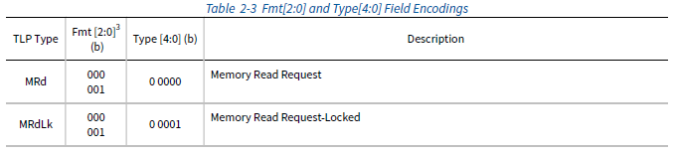
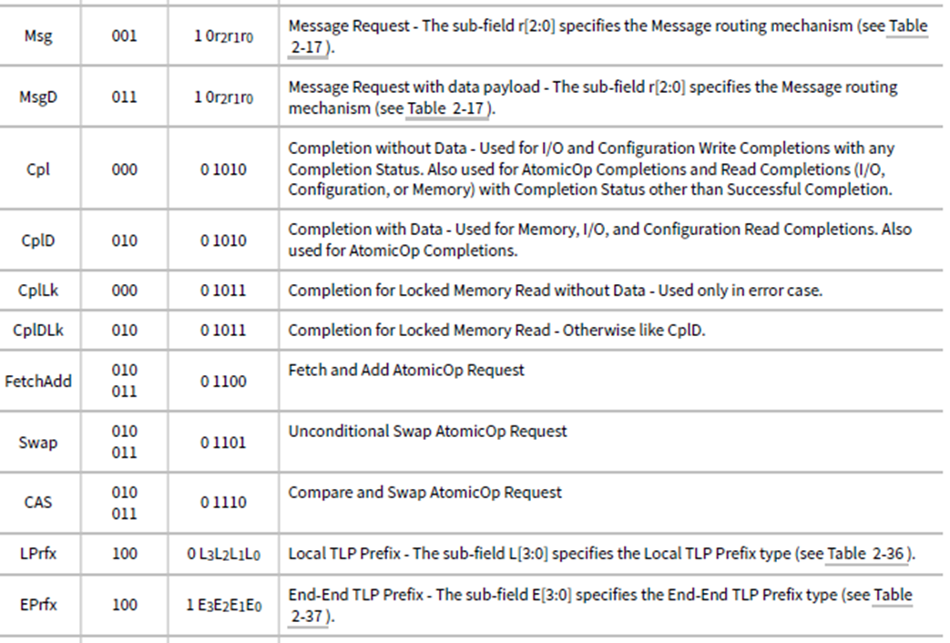
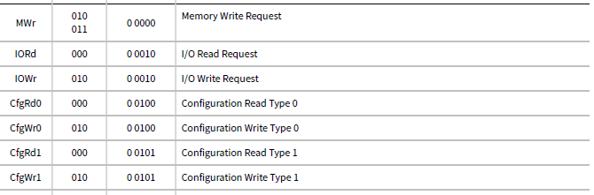
Address Space & Transaction Routing
TLP Routing Basics

Slide 33
Address Space & Transaction Routing
Applying Routing Mechanisms
Each request or completion header is tagged as to its type, and each of the packet types is routed based on one of three schemes:
•Address Routing
•ID Routing
•Implicit Routing
Memory and IO requests use address routing
Completions and Configuration cycles use ID routing
Message requests have selectable routing based on a 3-bit code in the message routing sub-field of the header type field

Slide 34
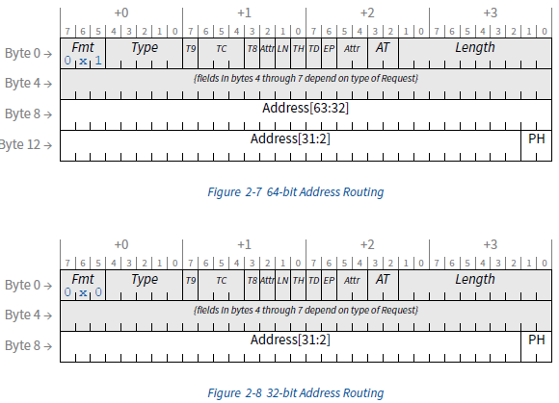
Address Space & Transaction Routing
Applying Routing Mechanisms
Address Routing
Notes:
TLP Hints (TH) - 1b indicates the presence of TLP Processing Hints (TPH) in the TLP header
If TH is Set, the PH field is encoded as shown in Table 2-15 . If TH is Clear, the PH field is Reserved.
Processing Hint Encoding

Slide 35
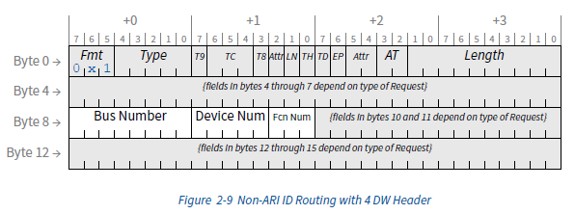
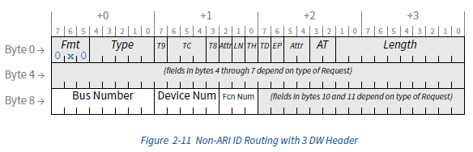
Address Space & Transaction Routing
Applying Routing Mechanisms
ID Routing
Notes:
In ARI (Alternative Routing-ID) Devices, Functions are only required to capture the Bus Number. ARI Devices are permitted to retain the captured Bus Number on either a per-Device or a per-Function basis. If the captured Bus Number is retained on a per-Device basis, all Functions are required to update and use the common Bus Number.

Slide 36
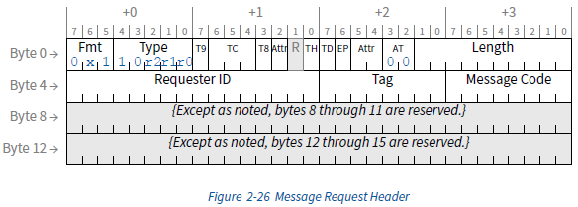

Address Space & Transaction Routing
Applying Routing Mechanisms
Implicit Routing
Notes:
“implicit” because no address or ID specifies the destination, but rather the destination is implied by the
routing type.
Implicit routing is used only with Message Requests, and is covered in Section 2.2.8

Slide 37
PCI Express
TLP & DLLP Elements

Slide 38

TLP Elements
Packet-Based Protocol

Slide 39


TLP Elements
TLP Assembly And Disassembly

Slide 40

DLLP Elements
Sending DLLPs

Slide 41

DLLP Elements
DLLP Packet Types

Slide 42
PCI Express
Flow Control

Slide 43


Flow Control
Buffers and Credits
Notes:
保證發送端的PCIe設備永遠不會發送接收端的PCIe設備不能接收的TLP。
Prevent receive buffer over-run and eliminates the need like disconnect, retry, wait-states.
在發送TLP之前，Flow Control必須先檢查接收埠是否有足夠的Buffer空間來接收這個TLP。每個PCIe設備最多支持8個VC，並且每個VC的FC Buffer是完全獨立的。
Flow Control機制是通過相鄰兩個埠的DataLink之間發送DLLP來實現的。在進行初始化的時候，接收端需要向發送端報告其Buffer的大小，在正常運行狀態時，會周期性地通過FC DLLPs來告知發送端，接收端的各個Buffer的大小。
相關的Buffer和FC Counter存在於Transaction Layer，將三類TLP分開存放，同時將Header與Data部分也分開存放。因此，一共存在六種不同的Flow Control Buffer類型
Flow Control Buffer的存儲單元（Unit）被稱作Flow Control Credits。對於Header來說，Requests TLP每個unit等於5DW，而Completions TLP每個unit等於4DW。對於Data來說，每個unit等於4DW，即Data Buffer是按照16個字節對齊的。

Slide 44


Flow Control
FC_Init1 & FC_Init2
Notes:
在FC_Init1步驟中，PCIe設備會連續地發送三個InitFC1類型的FC DLLP來報告其接收Buffer 的大小。三個DLLP的順序是固定的：Posted、Non-Posted然後是Completions。
FC_Init2與FC-Init1類似，同樣是連續的發送三個InitFC2類型的DLLP，當完成後，DLCMSM會切換到DL_Active狀態，表明DataLink初始化完成。

Slide 45


Flow Control
UpdateFC
Notes:
在完成FC初始化之後，相鄰的兩個設備之間會周期性的通過Updated FC DLLP更新接收Buffer的大小。
CC: Credits Consumed
CL: Credit Limit
PTLP: Pending TLP

Slide 46
PCI Express
ACK/NAK Protocol

Slide 47

ACK/NAK Protocol
Overview

Slide 48

ACK/NAK Protocol
Elements

Slide 49
PCI Express
Physical Layer - Logical

Slide 50


Physical Layer - Logical
Transmit / Receive Logic

Slide 51


Physical Layer - Logical
8b/10b & 128b/130b Encoding
Notes:
Block: 16 bytes with 2-bit Sync field
2-bit Sync field: Data(10b), Ordered Sets(01b)

Slide 52


Physical Layer - Logical
Byte Striping
Notes:
Control Characters:
STP and SDP characters are always sent on Lane 0.
END and EDB characters are always sent on Lane 3.
When an ordered set such as the SKIP is sent, it must appear on all lanes simultaneously.
When Logical Idles are transmitted, they must be sent on all lanes simultaneously.
Any violation of these rules may be reported as a Receiver Error to the Data Link Layer.

Slide 53


Physical Layer - Logical
Packet Format

Slide 54


Physical Layer - Logical
Ordered-Set
Notes:
Ordered Sets主要用於Link Management功能。對於Gen1/2的PCIe來說，所有都是按照DW對齊的（即四 bytes），且開頭也是一個叫做Comma（COM）的K字符（Control字符），隨後包含一些K字符或者D字符（Data字符）。
Ordered Sets是在每個Lane上同步發送的，即每一個Lane都會同時的發送相同的Ordered Sets，因此，也可以被用於Lane De-skewing。除了鏈路訓練之外，還被用於Clock Tolerance Compensation以及更改Link Power States。
The Electrical Idle Exit Ordered Set (EIEOS) is transmitted only when operating at speeds other than 2.5 GT/s. It is a low
frequency pattern transmitted periodically to help ensure that receiver Electrical Idle exit circuitry can detect an exit
from Electrical Idle. When using 128b/130b encoding, it is also used for Block Alignment

Slide 55
PCI Express
Link Initialization & Training

Slide 56


Link Initialization & Training
Overview
The following are discovered and determined during the training process:
• Link width (Link width negotiation)
• Link data rate (Link data rate negotiation)
• Lane reversal (Lane ordering within a Link)
• Lane polarity
Notes:
the Physical Layer control process that configures and initializes each Link for normal operation
• configuring and initializing the Link
• supporting normal packet transfers
• supported state transitions when recovering from Link errors
• restarting a Port from low power states.

Slide 57


Link Initialization & Training
Training Sequences
TS1 and TS2 Ordered Sets
Notes:
Training sequences are composed of Ordered Sets used for initializing bit alignment, Symbol alignment and to exchange
Physical Layer parameters.
Fast Training Sequence (FTS) is the mechanism that is used for bit and Symbol lock when transitioning from L0s to L0.

Slide 58

Link Initialization & Training
Link Training and Status State Machine (LTSSM)
Overview

Slide 59

Link Initialization & Training
Link Training and Status State Machine (LTSSM)
Detect
Notes:
The purpose of this state is to detect when a far end termination is present.

Slide 60

Link Initialization & Training
Link Training and Status State Machine (LTSSM)
Polling
Notes:
The Port transmits training Ordered Sets and responds to the received training Ordered Sets. In this state, bit lock and
Symbol lock are established and Lane polarity is configured.

Slide 61

Link Initialization & Training
Link Training and Status State Machine (LTSSM)
Configuration
Notes:
In Configuration, both the Transmitter and Receiver are sending and receiving data at the negotiated data rate. The
Lanes of a Port configure into a Link through a width and Lane negotiation sequence. Also, Lane-to-Lane de-skew must
occur, scrambling can be disabled if permitted, the N_FTS is set, and the Disabled or Loopback states can be entered.

Slide 62
Link Initialization & Training
Link Training and Status State Machine (LTSSM)
L0
L0 is the normal operational state where data and control packets can be transmitted and received. All power
management states are entered from this state.
Notes:
L0 is the normal operational state where data and control packets can be transmitted and received. All power
management states are entered from this state.

Slide 63

Link Initialization & Training
Link Training and Status State Machine (LTSSM)
Recovery
Notes:
In Recovery, both the Transmitter and Receiver are sending and receiving data using the configured Link and Lane
number as well as the previously supported data rate(s).
Recovery allows a configured Link to change the data rate of operation if desired, re-establish bit lock, Symbol lock or Block alignment, and Lane-to-Lane de-skew.

Slide 64


Link Initialization & Training
Link Training and Status State Machine (LTSSM)
L0s
Notes:
L0s is intended as a power savings state.
L0s allows a Link to quickly enter and recover from a power conservation state without going through Recovery.
The entry to L0s occurs after receiving an EIOS.
The exit from L0s to L0 must re-establish bit lock, Symbol lock or Block alignment, and Lane-to-Lane de-skew.
A Transmitter and Receiver Lane pair on a Port are not required to both be in L0s simultaneously.

Slide 65

Link Initialization & Training
Link Training and Status State Machine (LTSSM)
L1
Notes:
L1 is intended as a power savings state.
The L1 state allows an additional power savings over L0s at the cost of additional resume latency.
The entry to L1 occurs after being directed by the Data Link Layer and receiving an EIOS.

Slide 66

Link Initialization & Training
Link Training and Status State Machine (LTSSM)
L2
Notes:
Power can be aggressively conserved in L2. Most of the Transmitter and Receiver may be shut off. Main power and
clocks are not guaranteed, but Aux power is available.
The entry to L2 occurs after being directed by the Data Link Layer and receiving an EIOS.

Slide 67
PCI Express
Power Management

Slide 68

Power Management
Function Power Management
Device PM States
Notes:
PCIE supports four device power states (ACPI), D0, D1, D2, and D3. D0 is mandatory and is full-on state. D0 has D0 uninitialized and D0 active two sub-states. D1 and D2 are optional. D1 is light sleep and D2 is deep sleep. D3 is mandatory and is the lowest device power state. D3 is full-off state and has D3cold(w.o. Vcc) and D3hot(w. Vcc.) two sub-states.

Slide 69


Power Management
Function Power Management
PCI-PM Registers
Notes:
Bit31 to 16 of the 1st DW is PMC, power management capabilities. This is determined by device design. At enumeration, system software reads this 16bit to know device PM capability. Inside PMC, [2:0] is version. [3] is PME clock does not apply to PCI Express and must be hardwired to 0b. [9] is D1_support. [9]=1 indicates FUNCTION supports D1. [10] is D2_support. [10]=1 indicates function supports D2. [15:11] is PME_support indicating in which power states the function can send a PME message. Bit[15:11] correspond to D3cold, D3hot, D2, D1, and D0 state.
After system software, system driver, reads PMC, it can program [1:0] of PMCSR to put function into different power states. Driver can also read PMCSR[1:0] to know the device state status. PMCSR[15] is PME_status bit and driver reads this bit to query function PME event status
Data: optional, 8-bit read-only, Power Consumption/Dissipation(thermal), Units: Watts

Slide 70

Power Management
Link Power Management
State Flow Diagram
Notes:
By the time PCI Express was developed in 2002, additional “Link States,” or “L-States,” were included in the specification. These follow the template of the existing “D-States.” “L0” reflects a PCI Express link in full operation. “L1” is a link which is not transferring data but which can relatively quickly resume normal operation. “L2” and “L3” each reflect a link with main power removed (“L2” indicates an auxiliary power supply is active to provide “keep alive” power to devices). An “L0s” state was also defined in which each direction of the PCI Express link could be shut down independently with a quick resumption to normal operation. Fully active devices in “D0” can transition between “L0”, “L0s” and “L1” with no software intervention and thus save power on their own initiative without any operating system interaction.

Slide 71

Power Management
Link Power Management
State Characteristics

Slide 72

Power Management
Link Power Management
Relation Between Power Management States of Link and Components

Slide 73


Power Management
Active State Power Management (ASPM)
L0s State
L0s, also called L0 standby. L0s applied to a single direction of pcie link. So if device initiates L0s, device can put its tx into L0s while its rx is still in L0.
When either system or device side pcie phy hardware detects idle time on pcie link, it can put its tx into L0s state. It doesn’t need to tell higher layer software to block outbound TLP transactions. L0s exit is also initiated by the corresponding phy hw.
Notes:
Pcie device low power states require system driver to explicitly put device into low power states and pcie link can in turn go into low power link states. Pcie spec allows pcie link to go to low power states without system driver get involved. This feature is the so-called Active State Power Management (ASPM). In general, either system driver side hardware or device hardware can for example detect some idle time on pcie link and then initiate transition to move

Slide 74

Power Management
Active State Power Management (ASPM)
L1 ASPM State
Notes:
L1 entrance is different since L1 needs both directions to end up in L1. Below is how device requests the link to get into ASPM L1:
Device phy detects certain idle time on pcie link. Note this idle time is implementation dependent and is normally 7-10us. Device then blocks new outbound transaction to system.
Device keeps sending PM_Active_State_Request_L1 DLLP to system side until it receives PM_Request_ACK from system side.
System receives PM_Active_State_Request_L1, blocks new transaction to device, keeps sending PM_Request_ACK until receives electrical idle ordered set.
Device receives PM_Request_ACK, sends electrical idle ordered set, and puts its tx into electrical idle
System receives electrical idle, puts its tx into electrical idle. Now Pcie link is in ASPM L1 state.
Either system or device can initiate ASPM L1 exit.

Slide 75

Power Management
Power Management Event Mechanisms
PME Message
Notes:
Components may wakeup the system using a wakeup mechanism followed by a power management event (PME)
Message.
PCI Express systems may provide the optional auxiliary power supply (Vaux) needed for wakeup operation from states where the main power supplies are off.

Slide 76

Power Management
Power Management Event Mechanisms
Link Wake
Notes:
In Case 1, WAKE# is input directly to the Power Management Controller, and no translation is required.
In Case 2, WAKE# is an input to the Switch, and in response to WAKE# being asserted the Switch must generate a Beacon that is propagated to the Root Complex/Power Management Controller.

Slide 77


Power Management
L1 PM Substates
State Diagram
Notes:
Conventional L1 state is also the new L1.0 substate.
L1.1 consumes lower power than L1.0. This is because pcie ports are not required to be enabled to detect electrical idle. But pcie link common mode voltages are still maintained.
L1.2 is even lower power than L1.1 since link common mode voltages are not maintained.
Both L1.1 and L1.2 requires a bidirectional open-drain CLKREQ# for entry to and exit from the state.

Slide 78


Power Management
L1 PM Substates
Entry conditions
The following rules define how the L1.1 and L1.2 substates are entered:
When in PCI-PM L1.0 and the PCI-PM L1.2 Enable bit is Set, the L1.2 substate must be entered when CLKREQ# is deasserted.
When in PCI-PM L1.0 and the PCI-PM L1.1 Enable bit is Set, the L1.1 substate must be entered when CLKREQ# is deasserted and the PCI-PM L1.2 Enable bit is Clear.
When in ASPM L1.0 and the ASPM L1.2 Enable bit is Set, the L1.2 substate must be entered when CLKREQ# is deasserted and the reported LTR value last sent or received by this Port is greater than or equal to the value set by the LTR_L1.2_THRESHOLD Value and Scale fields.
When in ASPM L1.0 and the ASPM L1.1 Enable bit is Set, the L1.1 substate must be entered when CLKREQ# is deasserted and the conditions for entering the L1.2 substate are not satisfied.

Slide 79
PCI Express
Examples

Slide 80

Examples
Enumeration
PCI Map

Slide 81

Examples
PCI Config
Header0

Slide 82

Examples
PCI Config
PCIe Capability

Slide 83

Examples
NVMe
Controller Registers

Slide 84

Examples
Enumeration
PCI Map

Slide 85

Examples
PCI Config
Header0

Slide 86

Examples
NVMe
Set Features

Slide 87

Examples
NVMe
Identify Controller

Slide 88

Examples
NVMe
Read command

Slide 89
PCI Express
Q & A

Slide 90


Architecture
Device Layers
The Transaction Layer’s primary responsibility is the assembly and disassembly of TLPs. TLPs are used to communicate transactions, such as read and write, as well as certain types of events. The Transaction Layer is also responsible for managing credit-based flow control for TLPs.
The Data Link Layer, serves as an intermediate stage between the Transaction Layer and the Physical Layer. The primary responsibilities of the Data Link Layer include Link management and data integrity, including error detection and error correction. The Data Link Layer also generates and consumes DLLPs that are used for Link management functions.
The Physical Layer includes all circuitry for interface operation, including driver and input buffers, parallel-to-serial and serial-to-parallel conversion, PLL(s), and impedance matching circuitry. It also includes logical functions related to interface initialization and maintenance. This Layer is responsible for converting information received from the Data Link Layer into an appropriate serialized format and transmitting it across the PCI Express Link at a frequency and width compatible with the device connected to the other side of the Link.

Slide 91

Architecture
Transaction
Peer-to-Peer Transaction

Slide 92

Address Space & Transaction Routing
Base Address Registers (BARs)

Slide 93

Address Space & Transaction Routing
Base Address Registers (BARs)
Notes:
F900_0000h – F900_0FFFh (4KB in size)

Slide 94


Address Space & Transaction Routing
TLP Routing Basics

Slide 95

TLP Elements
TLP Assembly And Disassembly

Slide 96


Flow Control
Advertisement

Slide 97

Flow Control
FC_Init1 & FC_Init2

Slide 98

Flow Control
Example of Flow Control Initialization
Notes:
Figure 3-3 illustrates an example of the Flow Control initialization protocol for VC0 between a Switch and a
Downstream component. In this example, each component advertises the minimum permitted values for each
type of Flow Control credit. For both components the largest Max_Payload_Size value supported is 1024 bytes,
corresponding to a data payload credit advertisement of 040h. All DLLPs are shown as received without error.

Slide 99


Physical Layer - Logical
Mux and Control Logic

Slide 100


Physical Layer - Logical
Byte Striping

Slide 101


Physical Layer - Logical
8b/10b Encoding

Slide 102


Physical Layer - Logical
Scrambler

Slide 103

Link Initialization & Training
Overview

Slide 104

Link Initialization & Training
Link Training and Status State Machine (LTSSM)
Configuration
Link and Lane Number

Slide 105

Link Initialization & Training
Link Training and Status State Machine (LTSSM)
Configuration
Link Configuration Example 1

Slide 106


Link Initialization & Training
Link Training and Status State Machine (LTSSM)
Configuration
Link Configuration Example 1

Slide 107

Link Initialization & Training
Link Training and Status State Machine (LTSSM)
Configuration
Link Configuration Example 2

Slide 108


Link Initialization & Training
Link Training and Status State Machine (LTSSM)
Configuration
Link Configuration Example 2
Notes:
Implicit routing is used only with Message Requests, and is covered in Section 2.2.8

Slide 109


Link Initialization & Training
Link Training and Status State Machine (LTSSM)
Configuration
Link Configuration Example 3: Failed Lane
Notes:
Implicit routing is used only with Message Requests, and is covered in Section 2.2.8

Slide 110

Link Initialization & Training
Link Training and Status State Machine (LTSSM)
Configuration
Link Configuration Example 3: Failed Lane
Notes:
Implicit routing is used only with Message Requests, and is covered in Section 2.2.8

Slide 111


Link Initialization & Training
Link Training and Status State Machine (LTSSM)
Recovery
Link Equalization

Slide 112


Link Initialization & Training
Link Training and Status State Machine (LTSSM)
Recovery
Link Equalization

Slide 113


Link Initialization & Training
Link Training and Status State Machine (LTSSM)
Recovery
Link Equalization

Slide 114


Link Initialization & Training
Dynamic Bandwidth Changes
Dynamic Link Speed Changes
Notes:
To improve power consumption
To resolve reliability problems

Slide 115


Link Initialization & Training
Dynamic Bandwidth Changes
Dynamic Link Speed Changes

Slide 116


Link Initialization & Training
Dynamic Bandwidth Changes
Dynamic Link Width Changes

Slide 117


Link Initialization & Training
Dynamic Bandwidth Changes
Dynamic Link Width Changes

Slide 118

Link Initialization & Training
Dynamic Bandwidth Changes
Dynamic Link Width Changes

Slide 119


Power Management
Power Management Event Mechanisms
Link Wake

Slide 120

Power Management
Software Initiated Device Power Management
L1 State

Slide 121


Power Management
Software Initiated Device Power Management
L2/L3 Ready

Slide 122

Examples
Enumeration
PCI Map

Slide 123

Examples
PCI Config

Slide 124

Examples
PCI Config

